Slide 1
Reproducible research in R
Soumya banerjee

Slide 2
Rationale
Your data, your model decisions, parameters and your data filtering decisions will keep on changing.
How do you know 6 months later what has changed? Document your code and your output and your design decisions all in one place.
Reproducible pipeline
Know exactly what changed and when
Know how to rerun the analysis and get the (same) results
This is like your research notebook

Slide 3
Rationale
experiences/case studies of using Rmarkdown notebooks and helping biologists use them to analyze their own data
When you are deep in your work, it can be difficult to make code pretty, comment it and make it reproducible.
But you will regret not doing this when you park the work and 6 months later your colloaborators/reviewers ask for additional analysis or changing some assumption, etc.
Your code should then be ready (you should be able to click a button and reproduce the figures for your paper).

Slide 4


Case study
Notes:
Example of IL10 project (tSNE and heatmaps from a bioinformatics project)

Slide 5

Case study
Notes:
Example of IL10 project (tSNE and heatmaps from a bioinformatics project)

Slide 6
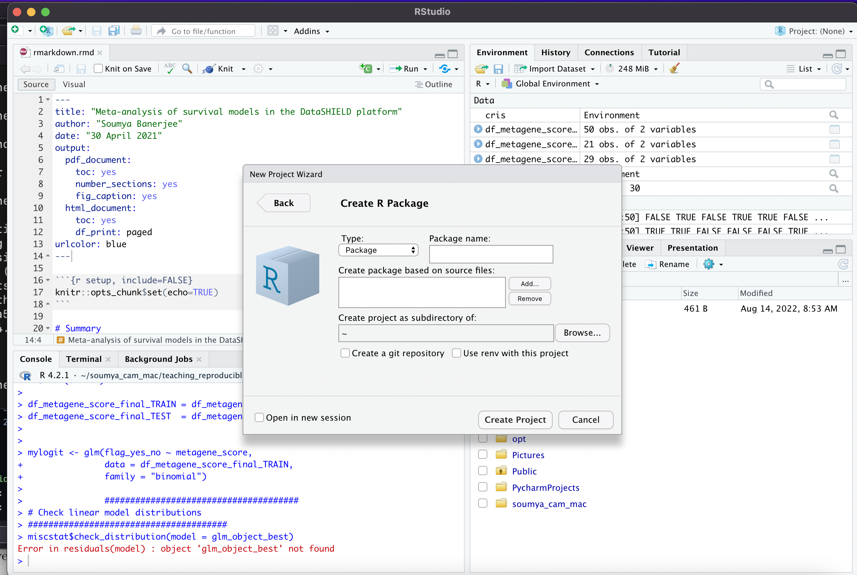
CREAting packages
Notes:
You can easily create R packages or Rmarkdown documents in R Studio

Slide 7
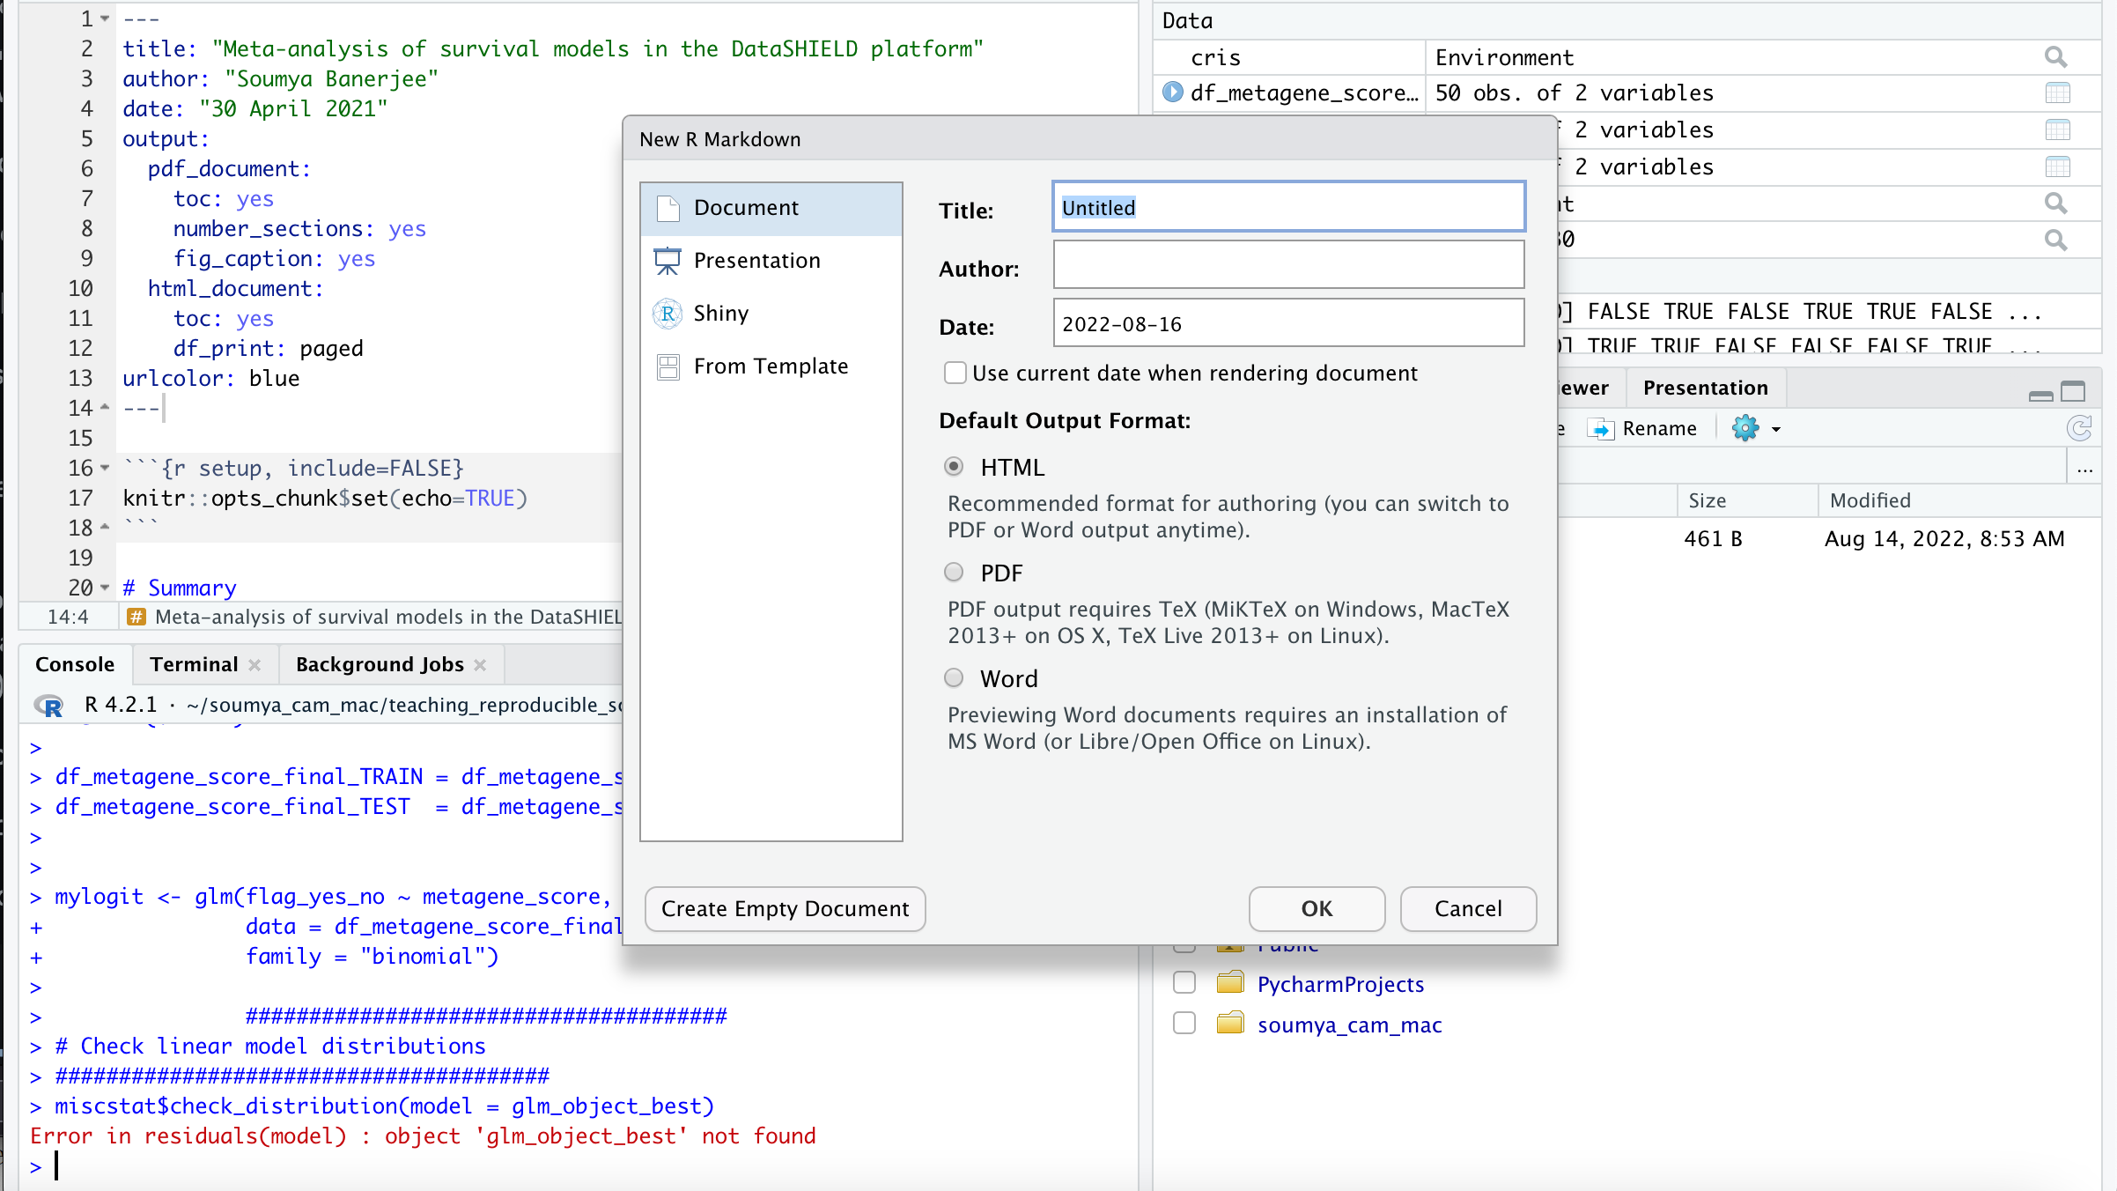
CREAting R MARKDOWN
Notes:
You can easily create R packages or Rmarkdown documents in R Studio

Slide 8
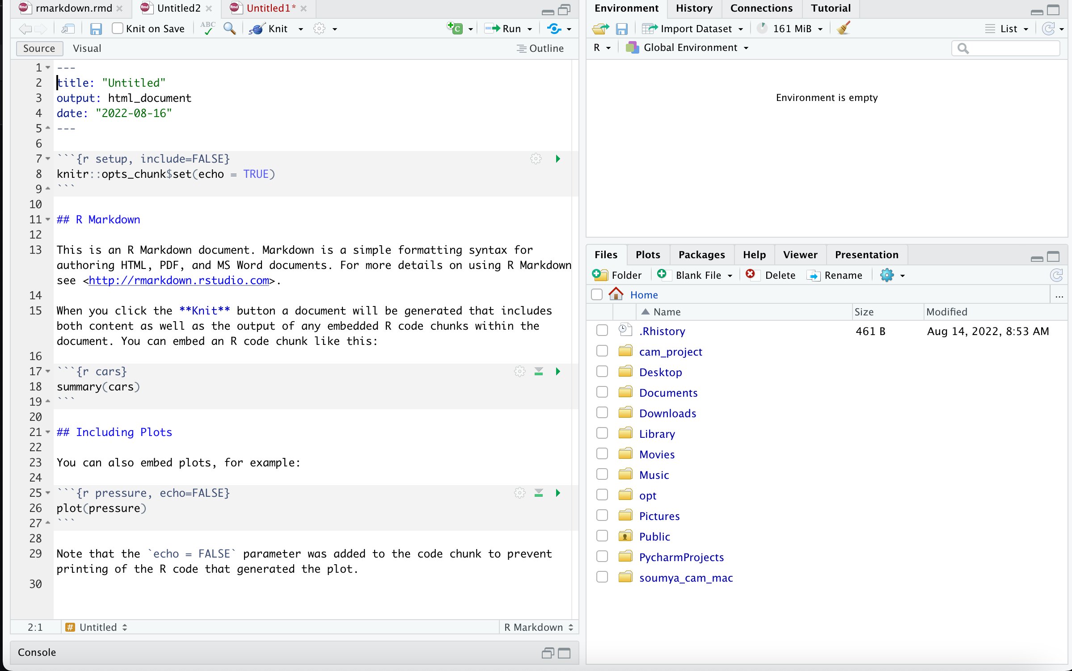
DEMO

Slide 9
R markdown basics
```r { } ```
include = FALSE prevents code and results from appearing in the finished file. R Markdown still runs the code in the chunk, and the results can be used by other chunks.
echo = FALSE prevents code, but not the results from appearing in the finished file. This is a useful way to embed figures.
message = FALSE prevents messages that are generated by code from appearing in the finished file.
warning = FALSE prevents warnings that are generated by code from appearing in the finished.
fig.cap = "..." adds a caption to graphical results.

Slide 10
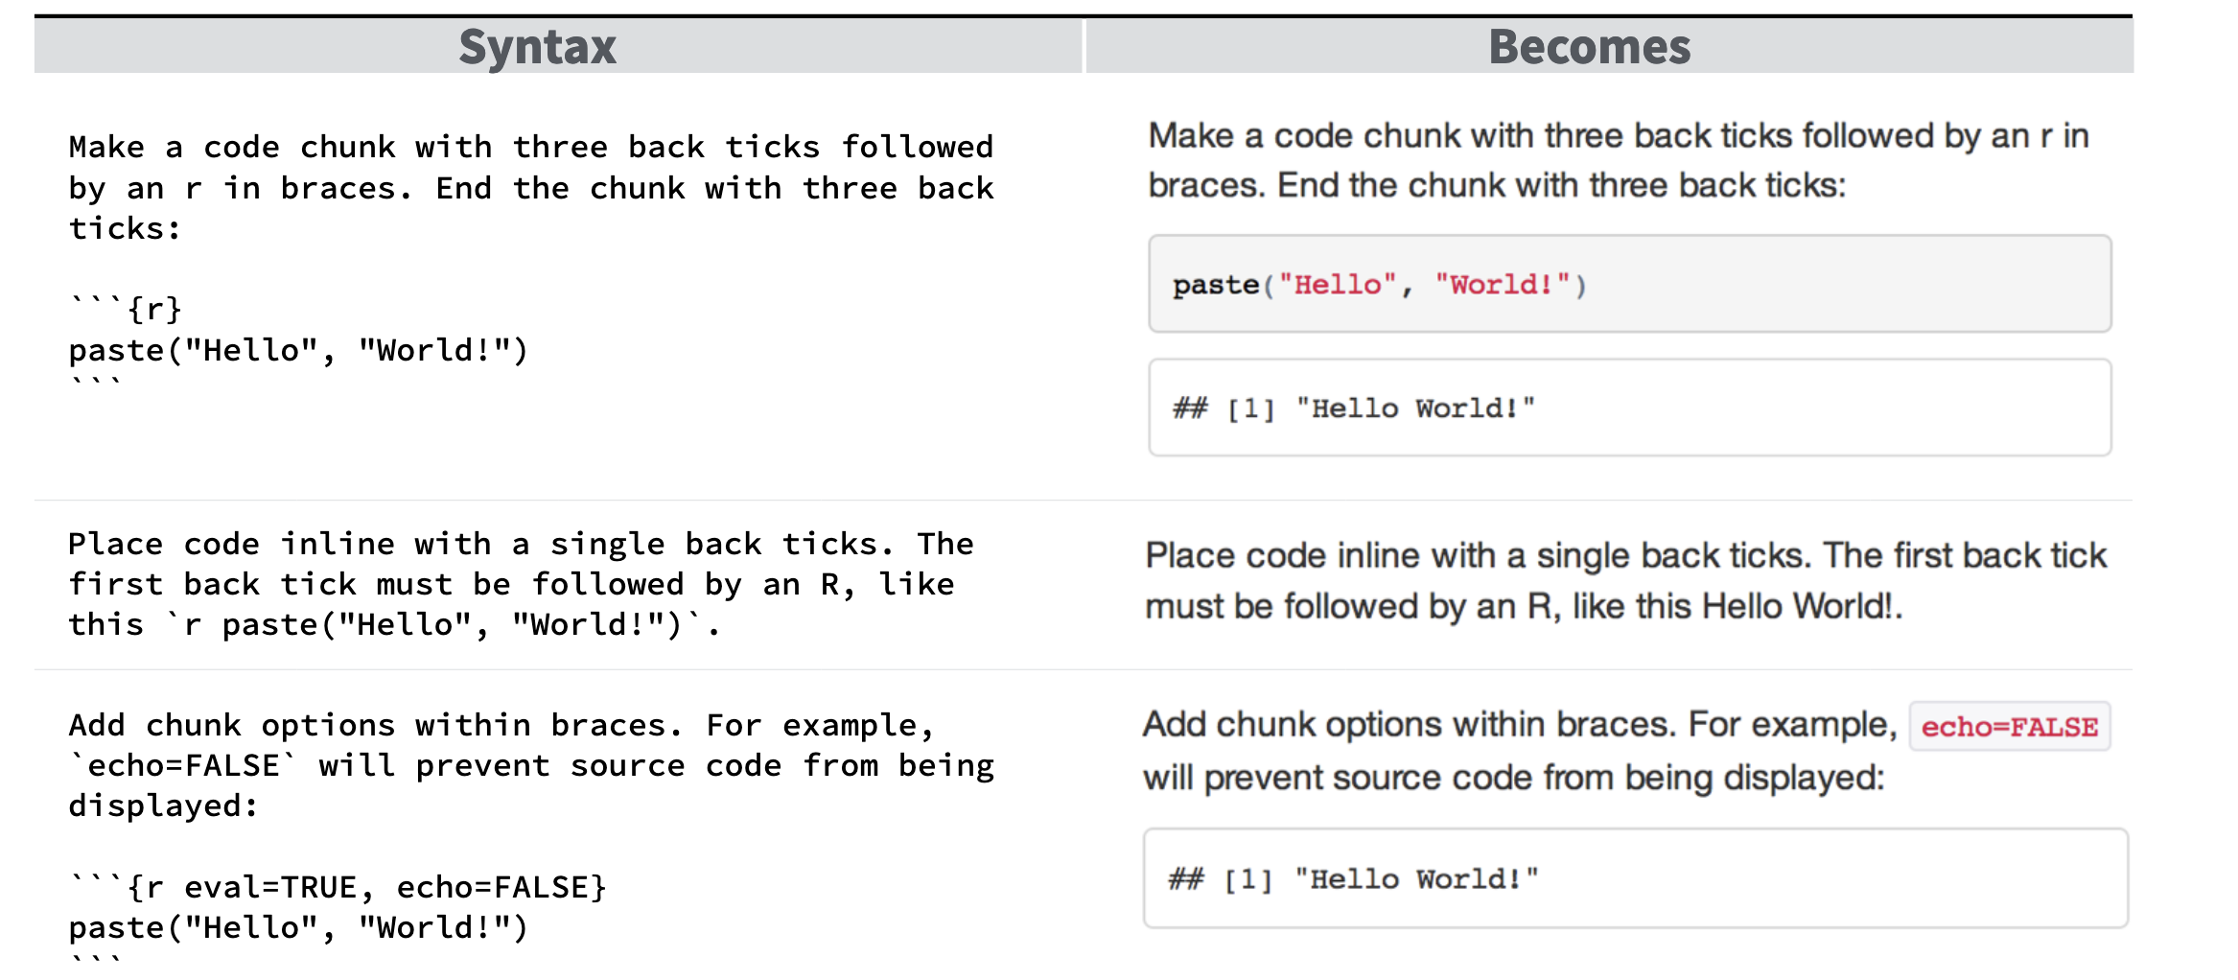
DEMO

Slide 11
Rationale
The concepts are the same in any programming language (R/Python)
Bottomline: we are all busy and we would all rather publish papers, but in the long term these best practices will make us more productive
This is like protocols (used in experimental biology) for computer scientists. Also like a lab notebook but for computational people.

Slide 12
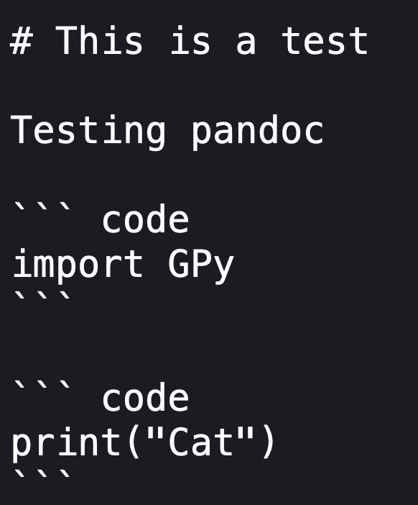
Concepts are language agnostic

Slide 13
Concepts are language agnostic
https://github.com/neelsoumya/teaching_reproducible_science_R/blob/main/tst.md
pandoc tst.md -o test.ipynb

Slide 14
DEMO
See the link below for more details
https://www.rstudio.com/wp-content/uploads/2015/03/rmarkdown-reference.pdf
Now head over to the file named rmarkdown.rmd
https://github.com/neelsoumya/teaching_reproducible_science_R/blob/main/rmarkdown.rmd
Running this will create a report like the following:
https://github.com/neelsoumya/teaching_reproducible_science_R/blob/main/rmarkdown.pdf

Slide 15
demo with rmarkdown from real-world project

Slide 16
EXERCISES with synthetic data

Slide 17
Graphical user interfaces
You can also easily create graphical user interfaces Here is a demo: https://sb2333medschl.shinyapps.io/shinyapp
code app.R: https://github.com/neelsoumya/teaching_reproducible_science_R/blob/main/shinyapp/app.R
DEMO

Slide 18
RESOURCES
https://github.com/neelsoumya/teaching_reproducible_science_R/
Code, resources and templates
EXERCISES with synthetic data
Installation instructions

